Slide 1
Proper PPE Use and Extended Use in the Long-Term Care Setting
This presentation is the property of WCEMS CHP – do not duplicate or use without permission

Slide 2
In this training, you will learn:
What is PPE?
How do I choose appropriate PPE?
How do I put on PPE?
How do I safely remove PPE?
How do I safely extend the use PPE?
How do I safely dispose of used PPE?

Slide 3
What is PPE?
Personal Protective Equipment includes clothing and/or equipment that is worn or used in order to provide protection against hazardous substances or environments.

Slide 4
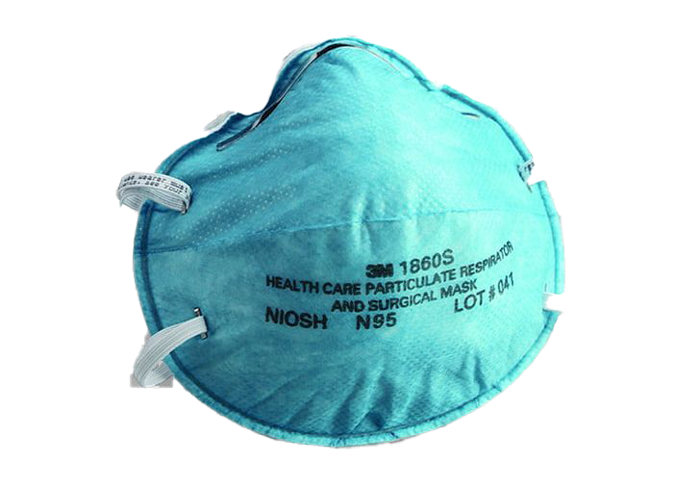
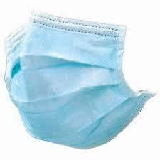
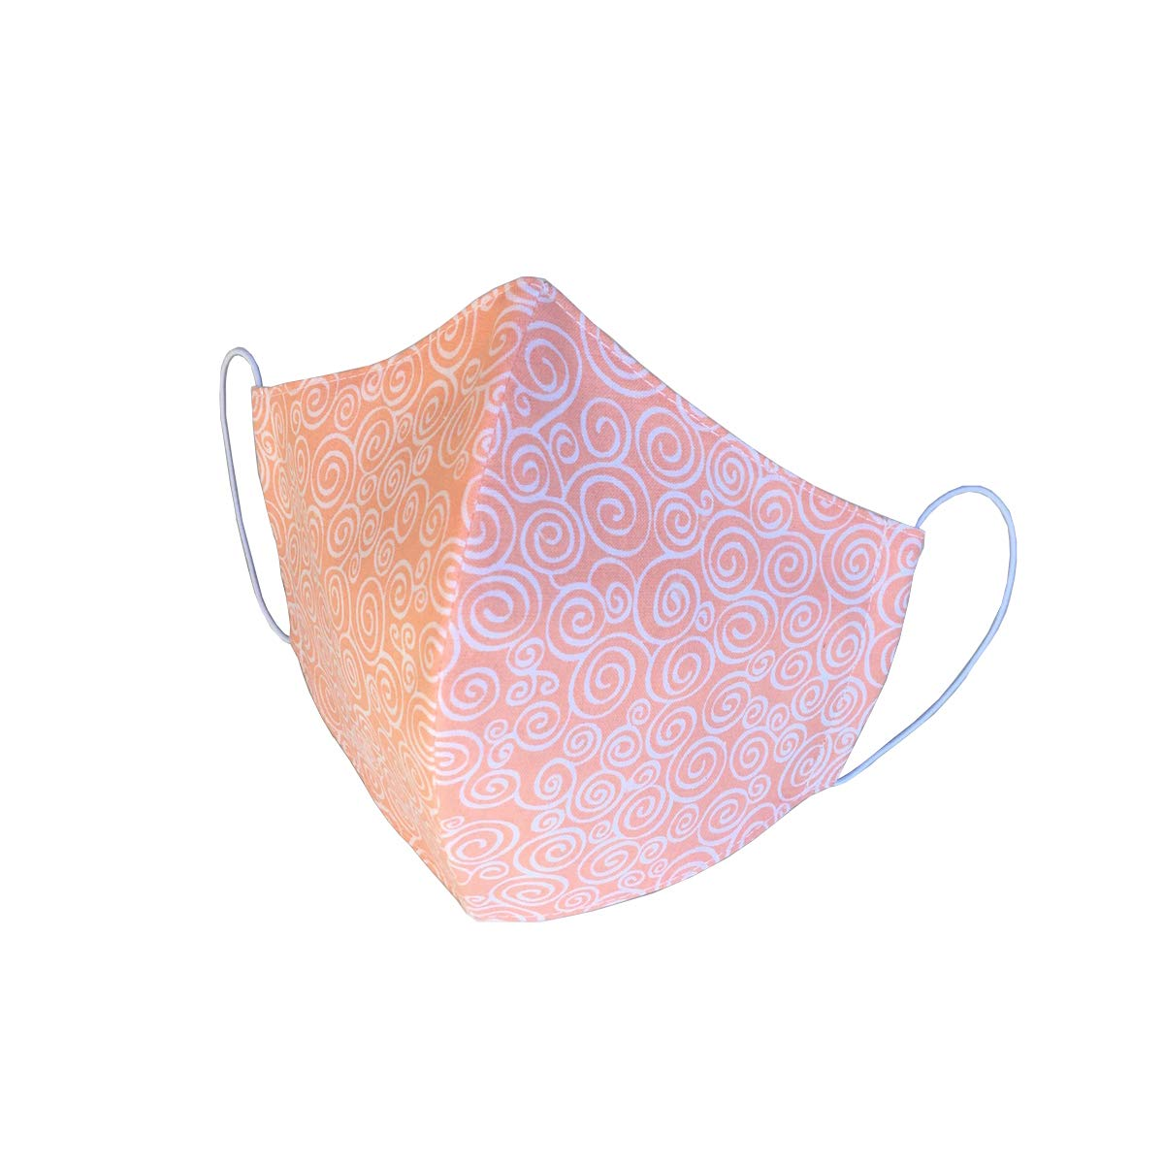
Types of PPE in the healthcare setting:
Cloth face coverings are intended for source control. They are not personal protective equipment (PPE) and it is uncertain whether cloth face coverings protect the wearer.
Facemasks are PPE and are often referred to as surgical masks or procedure masks. Use facemasks according to product labeling and local, state, and federal requirements. FDA-cleared surgical masks are designed to protect against splashes and sprays and are prioritized for use when such exposures are anticipated, including surgical procedures. Facemasks that are not regulated by FDA, such as some procedure masks, which are typically used for isolation purposes, may not provide protection against splashes and sprays.
Respirator is a personal protective device that is worn on the face, covers at least the nose and mouth, and is used to reduce the wearer’s risk of inhaling hazardous airborne particles (including dust particles and infectious agents), gases, or vapors. Respirators are certified by the CDC/NIOSH, including those intended for use in healthcare.

Slide 5
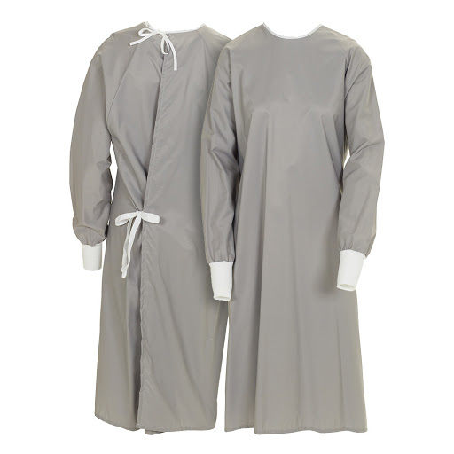
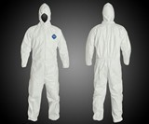
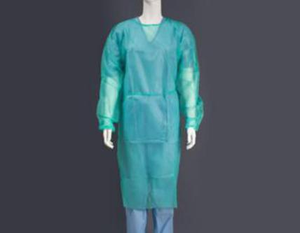
Gowns and Suits
Disposable Gown – designed to be discarded after a single use and typically constructed of nonwoven materials that offer protection from liquid penetration. “If the gown becomes visibly soiled, it must be removed and discarded as per usual practices.” Otherwise, the frequency of disposal will depend upon current extended and reuse practices. Under conventional gown use strategies, “disposable gowns should be discarded after each use.
Reusable Gown – cotton or polyester gown designed to be laundered after each use. “Any gown that becomes visibly soiled during resident care should be disposed of and cleaned.” Otherwise, the frequency of laundering will depend upon current extended and reuse practices. Under conventional gown use strategies, “cloth gowns should be laundered after each use.”
Suits – a suit or coverall that is one piece and sometimes has shoe covers and head covering built in; meant to be disposed of after use

Slide 6
N95 User Seal Check

Slide 7
Donning PPE
Identify and gather the proper PPE to don. Ensure choice of gown size is correct (based on training).
Perform hand hygiene using hand sanitizer.
Put on isolation gown. Tie all of the ties on the gown. Assistance may be needed by other healthcare personnel.
Put on NIOSH-approved N95 filtering facepiece respirator or higher (use a facemask if a respirator is not available). If the respirator has a nosepiece, it should be fitted to the nose with both hands, not bent or tented. Do not pinch the nosepiece with one hand. Respirator/facemask should be extended under chin. Both your mouth and nose should be protected. Do not wear respirator/facemask under your chin or store in scrubs pocket between patients.*
Respirator: Respirator straps should be placed on crown of head (top strap) and base of neck (bottom strap). Perform a user seal check each time you put on the respirator.
Facemask: Mask ties should be secured on crown of head (top tie) and base of neck (bottom tie). If mask has loops, hook them appropriately around your ears.
Put on face shield or goggles. When wearing an N95 respirator or half facepiece elastomeric respirator, select the proper eye protection to ensure that the respirator does not interfere with the correct positioning of the eye protection, and the eye protection does not affect the fit or seal of the respirator. Face shields provide full face coverage. Goggles also provide excellent protection for eyes, but fogging is common.
Put on gloves. Gloves should cover the cuff (wrist) of gown.
Healthcare personnel may now enter patient room.

Slide 8
Doffing PPE
Remove gloves. Ensure glove removal does not cause additional contamination of hands. Gloves can be removed using more than one technique (e.g., glove-in-glove or bird beak).
Remove gown. Untie all ties (or unsnap all buttons). Some gown ties can be broken rather than untied. Do so in gentle manner, avoiding a forceful movement. Reach up to the shoulders and carefully pull gown down and away from the body. Rolling the gown down is an acceptable approach. Dispose in trash receptacle. *
Healthcare personnel may now exit patient room.
Perform hand hygiene.
Remove face shield or goggles. Carefully remove face shield or goggles by grabbing the strap and pulling upwards and away from head. Do not touch the front of face shield or goggles.
Remove and discard respirator (or facemask if used instead of respirator). Do not touch the front of the respirator or facemask.*
Respirator: Remove the bottom strap by touching only the strap and bring it carefully over the head. Grasp the top strap and bring it carefully over the head, and then pull the respirator away from the face without touching the front of the respirator.
Facemask: Carefully untie (or unhook from the ears) and pull away from face without touching the front.
Perform hand hygiene after removing the respirator/facemask and before putting it on again if your workplace is practicing reuse.*

Slide 9
PPE Extended Use Guidance
N-95 Respirators
Goggles/Face Shields
Gowns
Extended use is favored over reuse as it involves less touching and constant donning/doffing
Discard N95 respirators following use during aerosol generating procedures.
Discard N95 respirators contaminated with blood, respiratory or nasal secretions, or other bodily fluids from patients.
Discard N95 respirators following close contact with, or exit from, the care area of any patient co-infected with an infectious disease requiring contact precautions.
Consider use of a cleanable face shield (preferred³) over an N95 respirator and/or other steps (e.g., masking patients, use of engineering controls) to reduce surface contamination.
Perform hand hygiene with soap and water or an alcohol-based hand sanitizer before and after touching or adjusting the respirator (if necessary, for comfort or to maintain fit).
Store respirators in a safe location, not touching other respirators and in a breathable container.
Respirators can be used again after >72 drying/rest time up to 5 times
Eye protection should be removed, cleaned, and disinfected if it becomes visibly soiled or difficult to see through.
If a disposable face shield or goggles is cleaned and disinfected, it should be dedicated to one HCP and cleaned and disinfected whenever it is visibly soiled or removed (e.g., when leaving the isolation area) prior to putting it back on. See protocol for removing and cleaning and disinfecting eye protection below.
Eye protection should be discarded if damaged (e.g., face shield or goggles can no longer fasten securely to the provider, if visibility is obscured and cleaning and disinfecting does not restore visibility).
HCP should take care not to touch their eye protection. If they touch or adjust their eye protection, they must immediately perform hand hygiene.
HCP should leave patient care area if they need to remove their eye protection. See protocol for removing, cleaning, and disinfecting eye protection below.
Protective eyewear (e.g., safety glasses, trauma glasses) with gaps between glasses and the face likely do not protect eyes from all splashes and sprays.
Nonsterile, disposable patient isolation gowns, which are used for routine patient care in healthcare settings, are appropriate for use by HCP when caring for patients with suspected or confirmed COVID-19. In times of gown shortages, surgical gowns should be prioritized for surgical and other sterile procedures.
routinely inspect, maintain (e.g., mend a small hole in a gown, replace missing fastening ties)
replace reusable gowns when needed (e.g., when they are thin or ripped)
store laundered gowns in a manner such that they remain clean until use.
If reuse is considered, gowns should be dedicated to care of individual patients. Any gown that becomes visibly soiled during patient care should be disposed of or, if reusable, laundered.

Slide 10
Optimizing PPE During Shortages

Slide 11
N-95 Respirators
Conventional Capacity:
Contingency Capacity:
Crisis Capacity:
Implement just-in-time fit testing
Limit respirators during training
Implement qualitative fit testing
Use alternatives to N95 respirators such as other filtering facepiece respirators, elastomeric respirators, and powered air purifying respirators
Additional guidance
Temporarily suspend annual fit testing
Use N95 respirators beyond the manufacturer-designated shelf life for training and fit testing
Extend the use of N95 respirators by wearing the same N95 for repeated close contact encounters with several different patients
Additional guidance on contingency capacity strategies
Additional guidance on extended use
Use respirators beyond the manufacturer designated shelf life for healthcare delivery
Use respirators approved under standards used in other countries
Implement limited re-use of N95 respirators. During times of crisis, it may be needed to practice limited re-use on top of extended use
Use additional respirators beyond the manufacturer-designated shelf life that have not been evaluated by NIOSH
Prioritize the use of N95 respirators and facemasks by activity
Additional guidance on crisis capacity strategies
Additional guidance on re-use

Slide 12
Gowns
Conventional Capacity:
Contingency Capacity:
Crisis Capacity:
Use isolation gown alternatives that offer equivalent or higher protection
Additional guidance
Shift gown use toward cloth isolation gowns
Consider the use of coveralls
Use gowns beyond the manufacturer-designated shelf life for training
Use gowns or coveralls conforming to international standards
Additional guidance
Extend the use of isolation gowns
Re-use cloth isolation gowns
Prioritize gowns for activities where splashes and sprays are anticipated and during high-contact patient care
When no gowns are available:
Consider using gown alternatives that have not been evaluated as effective
Additional guidance

Slide 13
Eye Protection
Conventional Capacity:
Contingency Capacity:
Crisis Capacity:
Use eye protection according to product labeling and local, state, and federal requirements
Additional guidance
Shift eye protection supplies from disposable to re-usable devices
Extend the use of eye protection
Additional guidance
Use eye protection devices beyond the manufacturer-designated shelf life
Prioritize eye protection for activities where splashes and sprays are anticipated or prolonged face-to-face or close contact is unavoidable
Consider using safety glasses that cover the sides of eyes
Additional guidance

Slide 14
PPE Disposal
Treat all waste as infectious waste and handle it with care.
Use single use disposal gloves to handle any waste or trash bags.
Seal or tie off all trash bags so that waste cannot escape easily. Double bag if there are any concerns with the durability of the bag.
The Center for Disease Control and Prevention (CDC) and the World Health Organization (WHO) recommend that the management of waste materials related to COVID-19 from healthcare facilities should be performed in accordance with routine handling procedures for medical waste (for example: lab specimens, sharps, cleaning cloths, wipes, single-use microfiber cloths, etc.)
CDC’s guidance states that management of laundry, food service utensils, and medical waste should be performed in accordance with routine procedures. There is no evidence to suggest that facility waste needs any additional disinfection.

Slide 15
Questions
Amy S Jarosek, LP CHW
512-942-9041

